Slide 1
Feedback
June 2022
how to get what you need
and love what you get

Slide 2
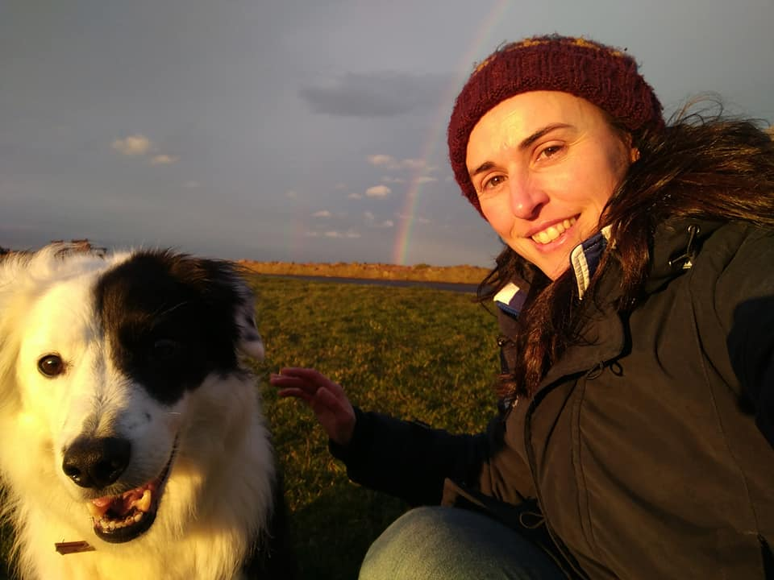






Hi! This is me
Milly Shaw
Senior Content Designer, Opencast Software

Slide 3
Today’s session
1
2
3
4
Preparing yourself for feedback
Feedback from your peers
Feedback from experts
Feedback from stakeholders

Slide 4
Preparing yourself for feedback

Slide 5
perfect perfect perfect perfect perfect perfect perfect perfect perfect perfect perfect perfect perfect perfect perfect perfect perfect perfect perfect perfect perfect perfect perfect perfect perfect perfect perfect perfect perfect perfect perfect perfect perfect perfect perfect perfect perfect perfect perfect perfect perfect perfect perfect perfect perfect perfect perfect perfect perfect perfect perfect perfect perfect perfect perfect perfect perfect perfect perfect perfect perfect perfect perfect perfect perfect perfect perfect perfect perfect perfect perfect perfect perfect perfect perfect perfect perfect perfect perfect perfect perfect perfect perfect perfect perfect perfect perfect perfect perfect perfect perfect perfect perfect perfect perfect perfect perfect perfect perfect perfect perfect perfect perfect perfect perfect perfect perfect perfect perfect perfect perfect perfect perfect perfect perfect perfect perfect perfect perfect perfect perfect perfect perfect perfect perfect perfect perfect perfect
Notes:
You don’t need feedback if you’re a good content designer. In fact, if you’re as good as you claim to be, everything you write should be perfect first time - and if it’s not, you’re a failure. Not only that, but anyone who suggests you haven’t written the most spectacular piece of content possible must hate you. They think you’re a fool, an imposter, and they’re laughing at you.
Ridiculous? Of course. But there is also a tiny truth hidden in all that nonsense. It’s a natural instinct to fear feedback, and to take criticism of our work as a criticism of ourselves.

Slide 6
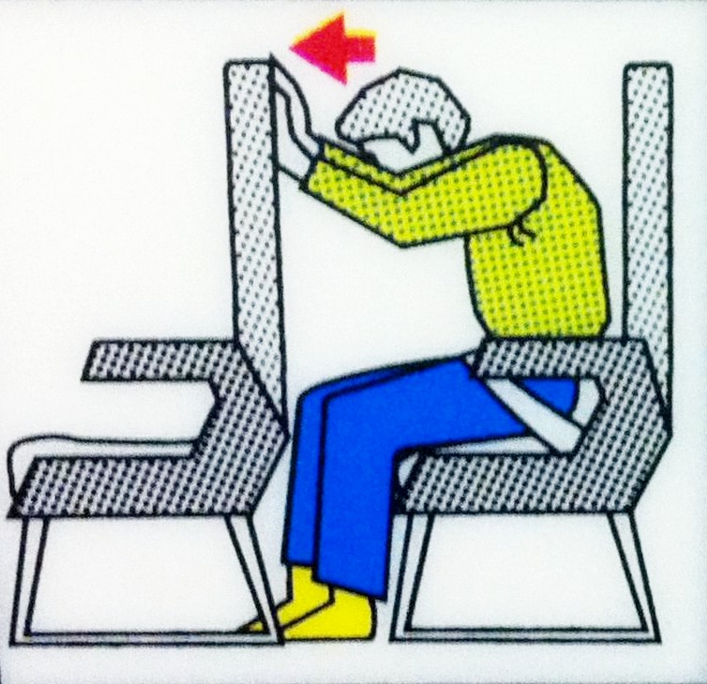
Preparing Bracing for feedback
Notes:
“bracing” for feedback And that’s how it can feel, right? Something terrible is coming, and we’re powerless to do anything about it.
But that’s not true, as I’ll be showing you.
But feedback is an essential part of the job, so we need to learn to manage the process. The first part of this process is mentally preparing for it.

Slide 7
Preparing for feedback
It’s about your work, not you

Slide 8
your job title
who you work for
the project you work on
the work you produce
Notes:
Many of us make our professional lives a central part of our identity. There’s nothing inherently wrong with that, but it’s important to remember you are not the sum of these things. It’s an unhealthy way of thinking about yourself, especially because some of these are out of your control.

Slide 9

your job title
who you work for
the project you work on
the work you produce
Notes:
In particular, because this talk is about feedback – the work you produce is not who you are.
You are not your work. Sounds obvious, but it’s worth stressing the point.
If someone’s really bad at giving feedback they might say something like ‘this page is awful, it does more harm than good, I hate it.’ Wow. Not nice to hear about your work. But don’t make the mistake of hearing “YOU are awful, YOU do more harm than good, I hate YOU”. Never take criticism of your work as criticism of you.

Slide 10
Preparing yourself for feedback
2. This will make you a better content designer
Notes:
If someone points out a grammatical error, a better way to express a thought, or an obvious style guide point you’ve forgotten, that’s ok. It doesn’t mean you’re a bad writer. It literally just means you didn’t get these particular things right this time.

Slide 11
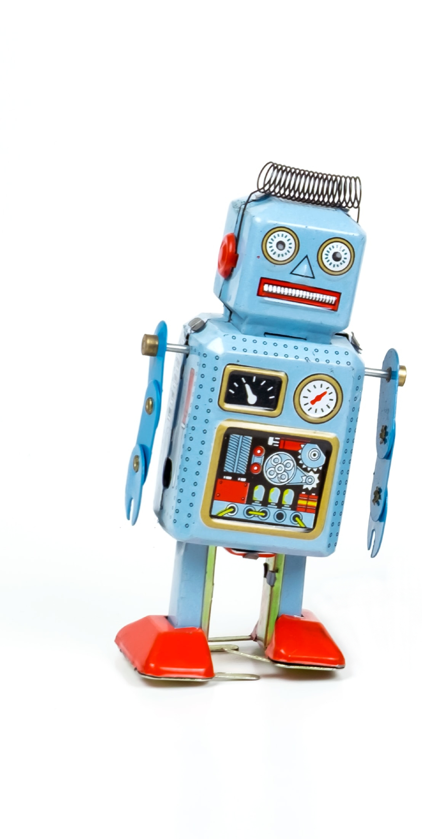
Notes:
We’re humans, not machines, and sometimes we will make mistakes. It doesn’t have any impact on who you are or your abilities as a content designer. We all have our blind spots, and if you notice the same comments coming up over time, see it as an opportunity to learn. Content design is a skill, and like any skill, the more you do it the more you will improve - particularly when you pay close attention to your weaker areas.

Slide 12
Preparing yourself for feedback
3. You want this, and you’re in control
Notes:
Remember, feedback is a non-negotiable part of the job. So you might as well take control of it. Control who you get feedback from, when you get it, and how you respond to it.

Slide 13

Notes:
Feedback shouldn’t feel like a passive act for you. You’re not a cat that someone has dressed up, and you hate it but you can’t do anything about it.
Instead, reframe feedback as something you are actively seeking out, to help you create better work.

Slide 14
Preparing yourself for feedback
4. Ask at 80%
Notes:
Ask for feedback when something is 80% done, not 100%.
At 100% you’ve done the very best you can, you’re invested in it, and psychologically you’re ready to move onto the next thing.
Frankly, it’s depressing.

Slide 15
80%
Notes:
Let’s reiterate this point
At 80% you know it’s roughly right but still needs some work, and it won’t feel so jarring when people suggest improvements to it.
It will also speed up your work, because that final 20% will get done fast with recommendations and ideas from colleagues and stakeholders.

Slide 16
Feedback from your peers

Slide 17
Content crits
Highly structured meetings
Detailed feedback from other (content) designers
Notes:
A content crit is a highly structured meeting where you share your work with other content designers, and they help you improve it.

Slide 18

Notes:
What they’re not, is a load of people ganging up you to criticism your work.
Done well they’re actually really fun – you get a fresh perspective on your work from people, and they’re a chance for content designers to get together and geek out about what they love - content design.

Slide 19
When asking for feedback:
Give some background
Say exactly what you want feedback on

Slide 20
When giving feedback:
Be specific
Talk about the work, not the person
Be constructive

Slide 21
When receiving feedback:
Don't talk too much
Take notes

Slide 22
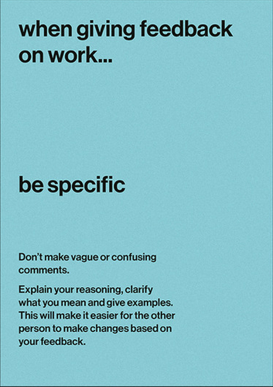
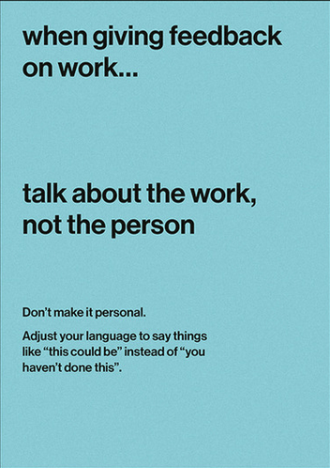
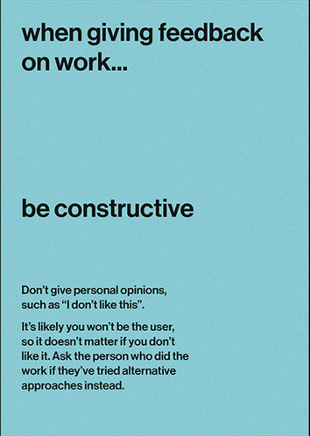
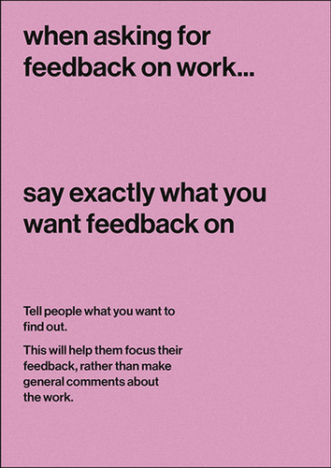
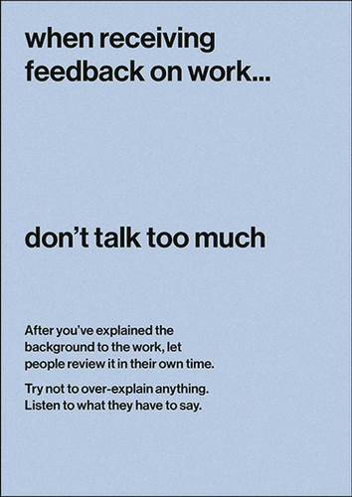
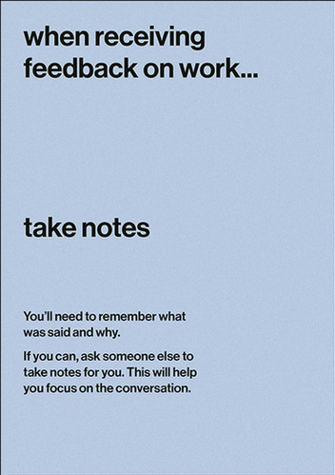
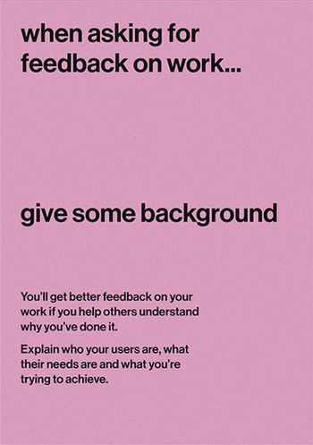
Credit: Chris Ballantine-Thomas and Tom Hughes
govdesign.tumblr.com
Notes:
7-page poster which does that already. It created by a couple of designers working within the UK government.

Slide 23
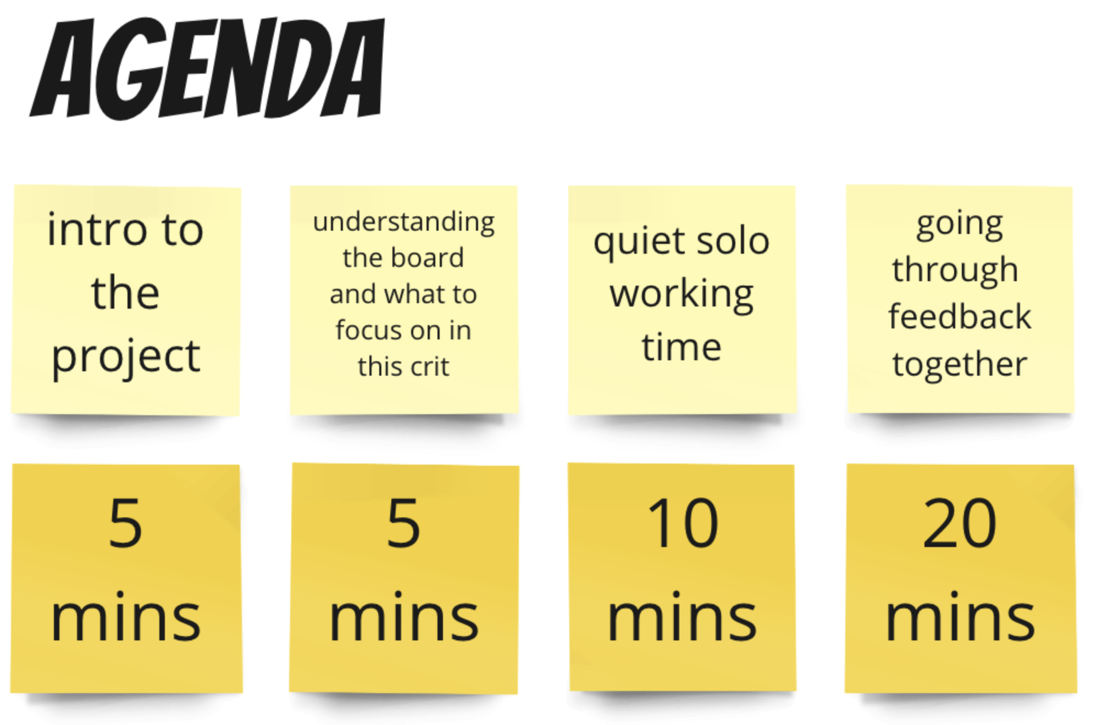
Notes:
As with any workshop, time-keeping is really important. You need to give people enough context to understand the work, then they need time to think, then you need time to discuss it together.

Slide 24
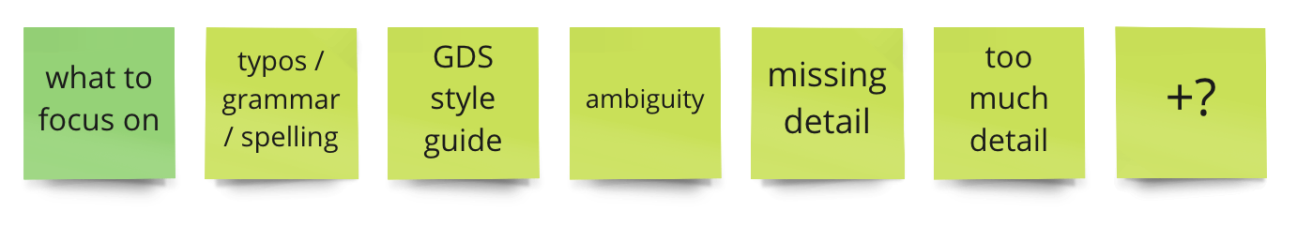
Notes:
In addition, make it very clear what you want feedback on. This is especially important for more junior content designers, who may feel intimidated pointing out errors.

Slide 25
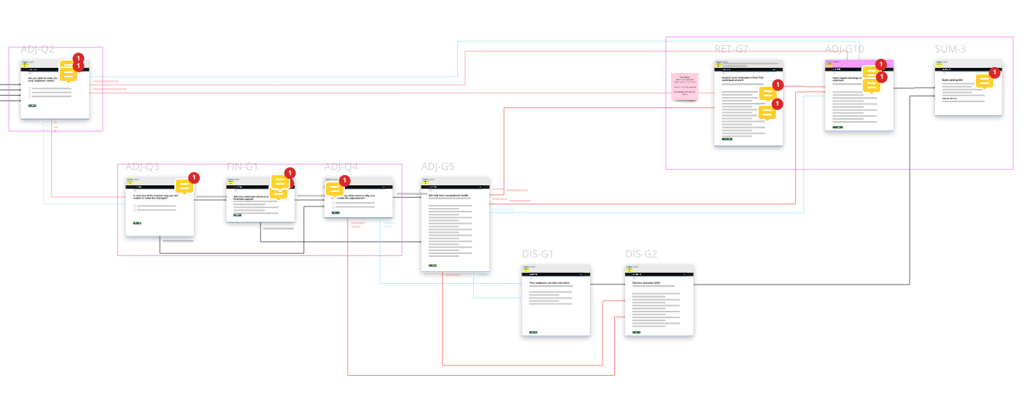
Notes:
I thought it might be useful to see what a crit actually looks like. This is a journey I worked on. I put pink boxes around the pages I wanted people to focus on, and they left comments with their notes. While they were writing them I was looking at what they said, and I made a note of any comments I thought it would be useful to discuss.

Slide 26
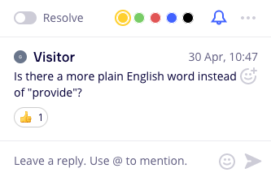
Notes:
Comments about plain language

Slide 27
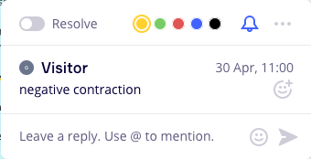
Notes:
The style guide I was using didn’t allow negative contractions

Slide 28
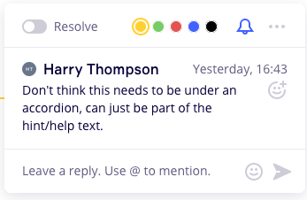
Notes:
This one was about how the content was displayed on the page

Slide 29
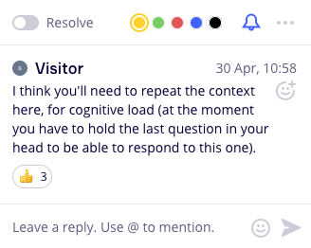
Notes:
A really helpful reminder about cognitive load – this is why it’s good to get a fresh perspective with someone who’s not been working on it

Slide 30
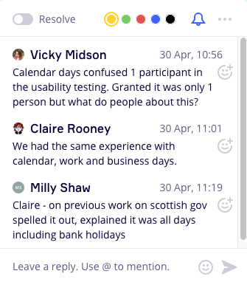
Notes:
Miro comments are useful for threaded conversations

Slide 31
Feedback from experts

Slide 32
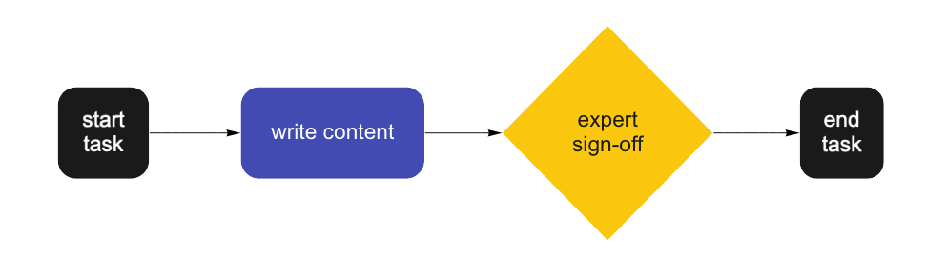
Never happens

Slide 33
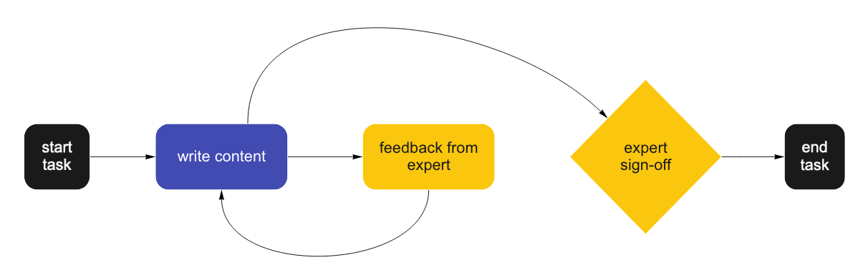
Wishful thinking

Slide 34
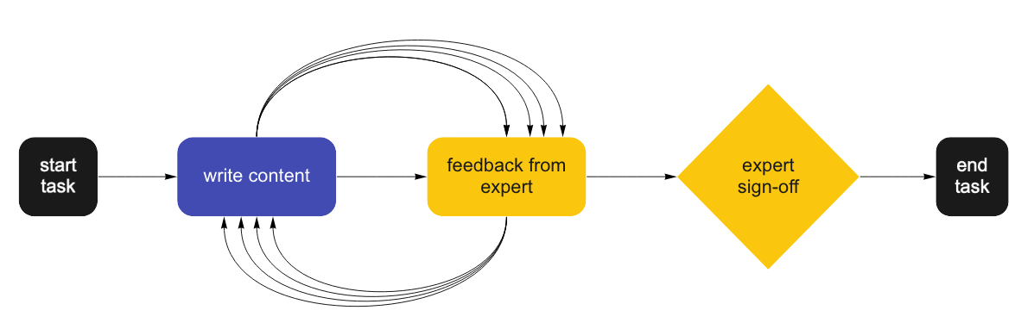
Happens depressingly often

Slide 35
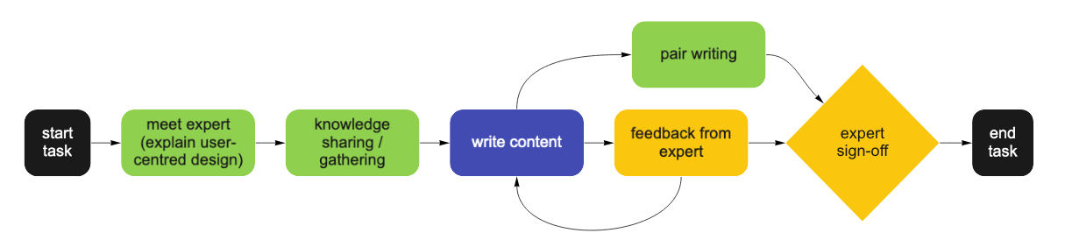
A better approach

Slide 36
A better approach

Slide 37
How to ask an expert for feedback
Be clear about:
What you want feedback on
What you don’t want feedback on
How you want to receive the feedback
Your deadline
What’s next

Slide 38
Feedback from stakeholders
Notes:
“stakeholders” is whoever is driving the project – often the people who signed off the budget.

Slide 39
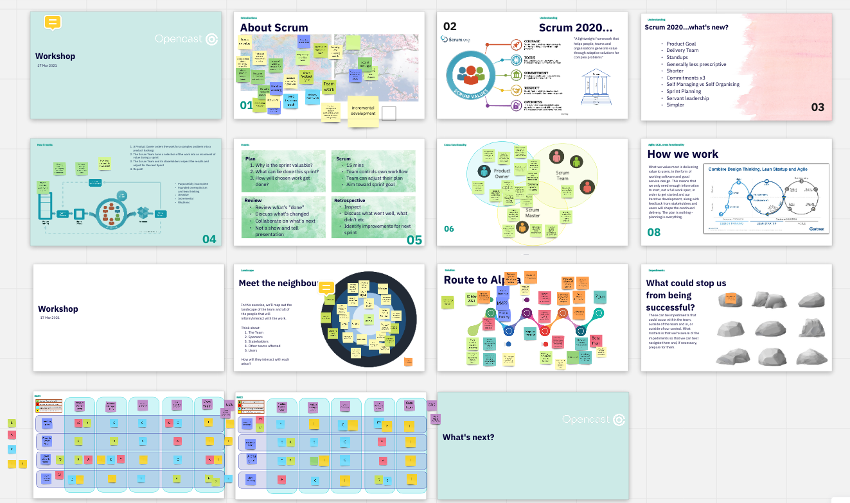
Establish ‘Ways of Working’
Notes:
Ways of working: get right people lined up at start of project
Different stakeholders (experts, legal, product owner / policy owner), different involvement (RACI)
Ways of working: explaining everyone’s roles (relates to RACI), how important is the user in your work (sets your expectations, will help later on in disputes)
Agree when to give updates – sprint cadence

Slide 40
Responsible Accountable Consulted Informed

Slide 41
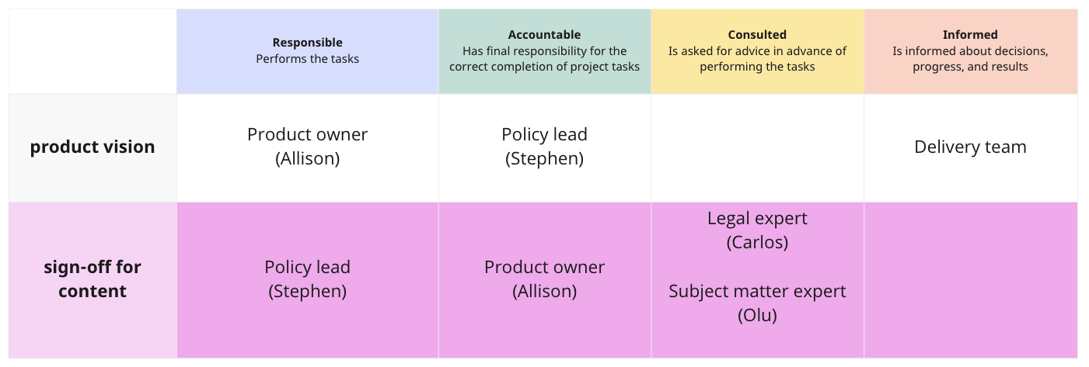
RACI

Slide 42

Notes:
Things don’t always go according to plan.

Slide 43
“Just change it to what I want”
What’s the root of the issue?

Slide 44


Slide 45
“Just change it to what I want”
2. Invite them to user research sessions

Slide 46
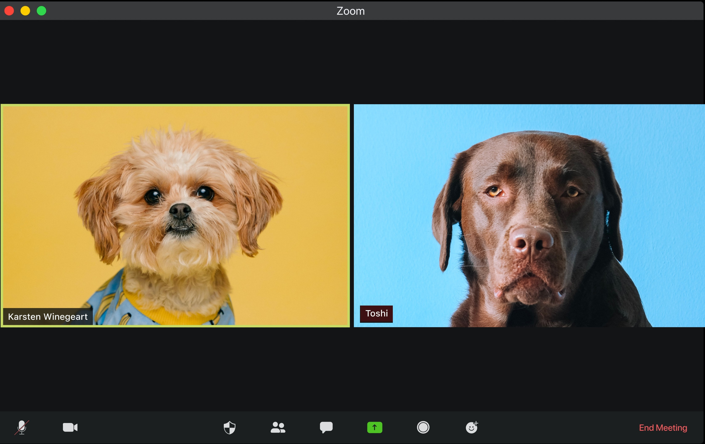
Notes:
Best path (from UCD PoV) Invite them to UR sessions (building empathy with users). ‘User needs’ can feel vague and hypothetical. But seeing real users struggle is different. Work with UR to tell a good story.

Slide 47
“Just change it to what I want”
3. What motivates them?

Slide 48
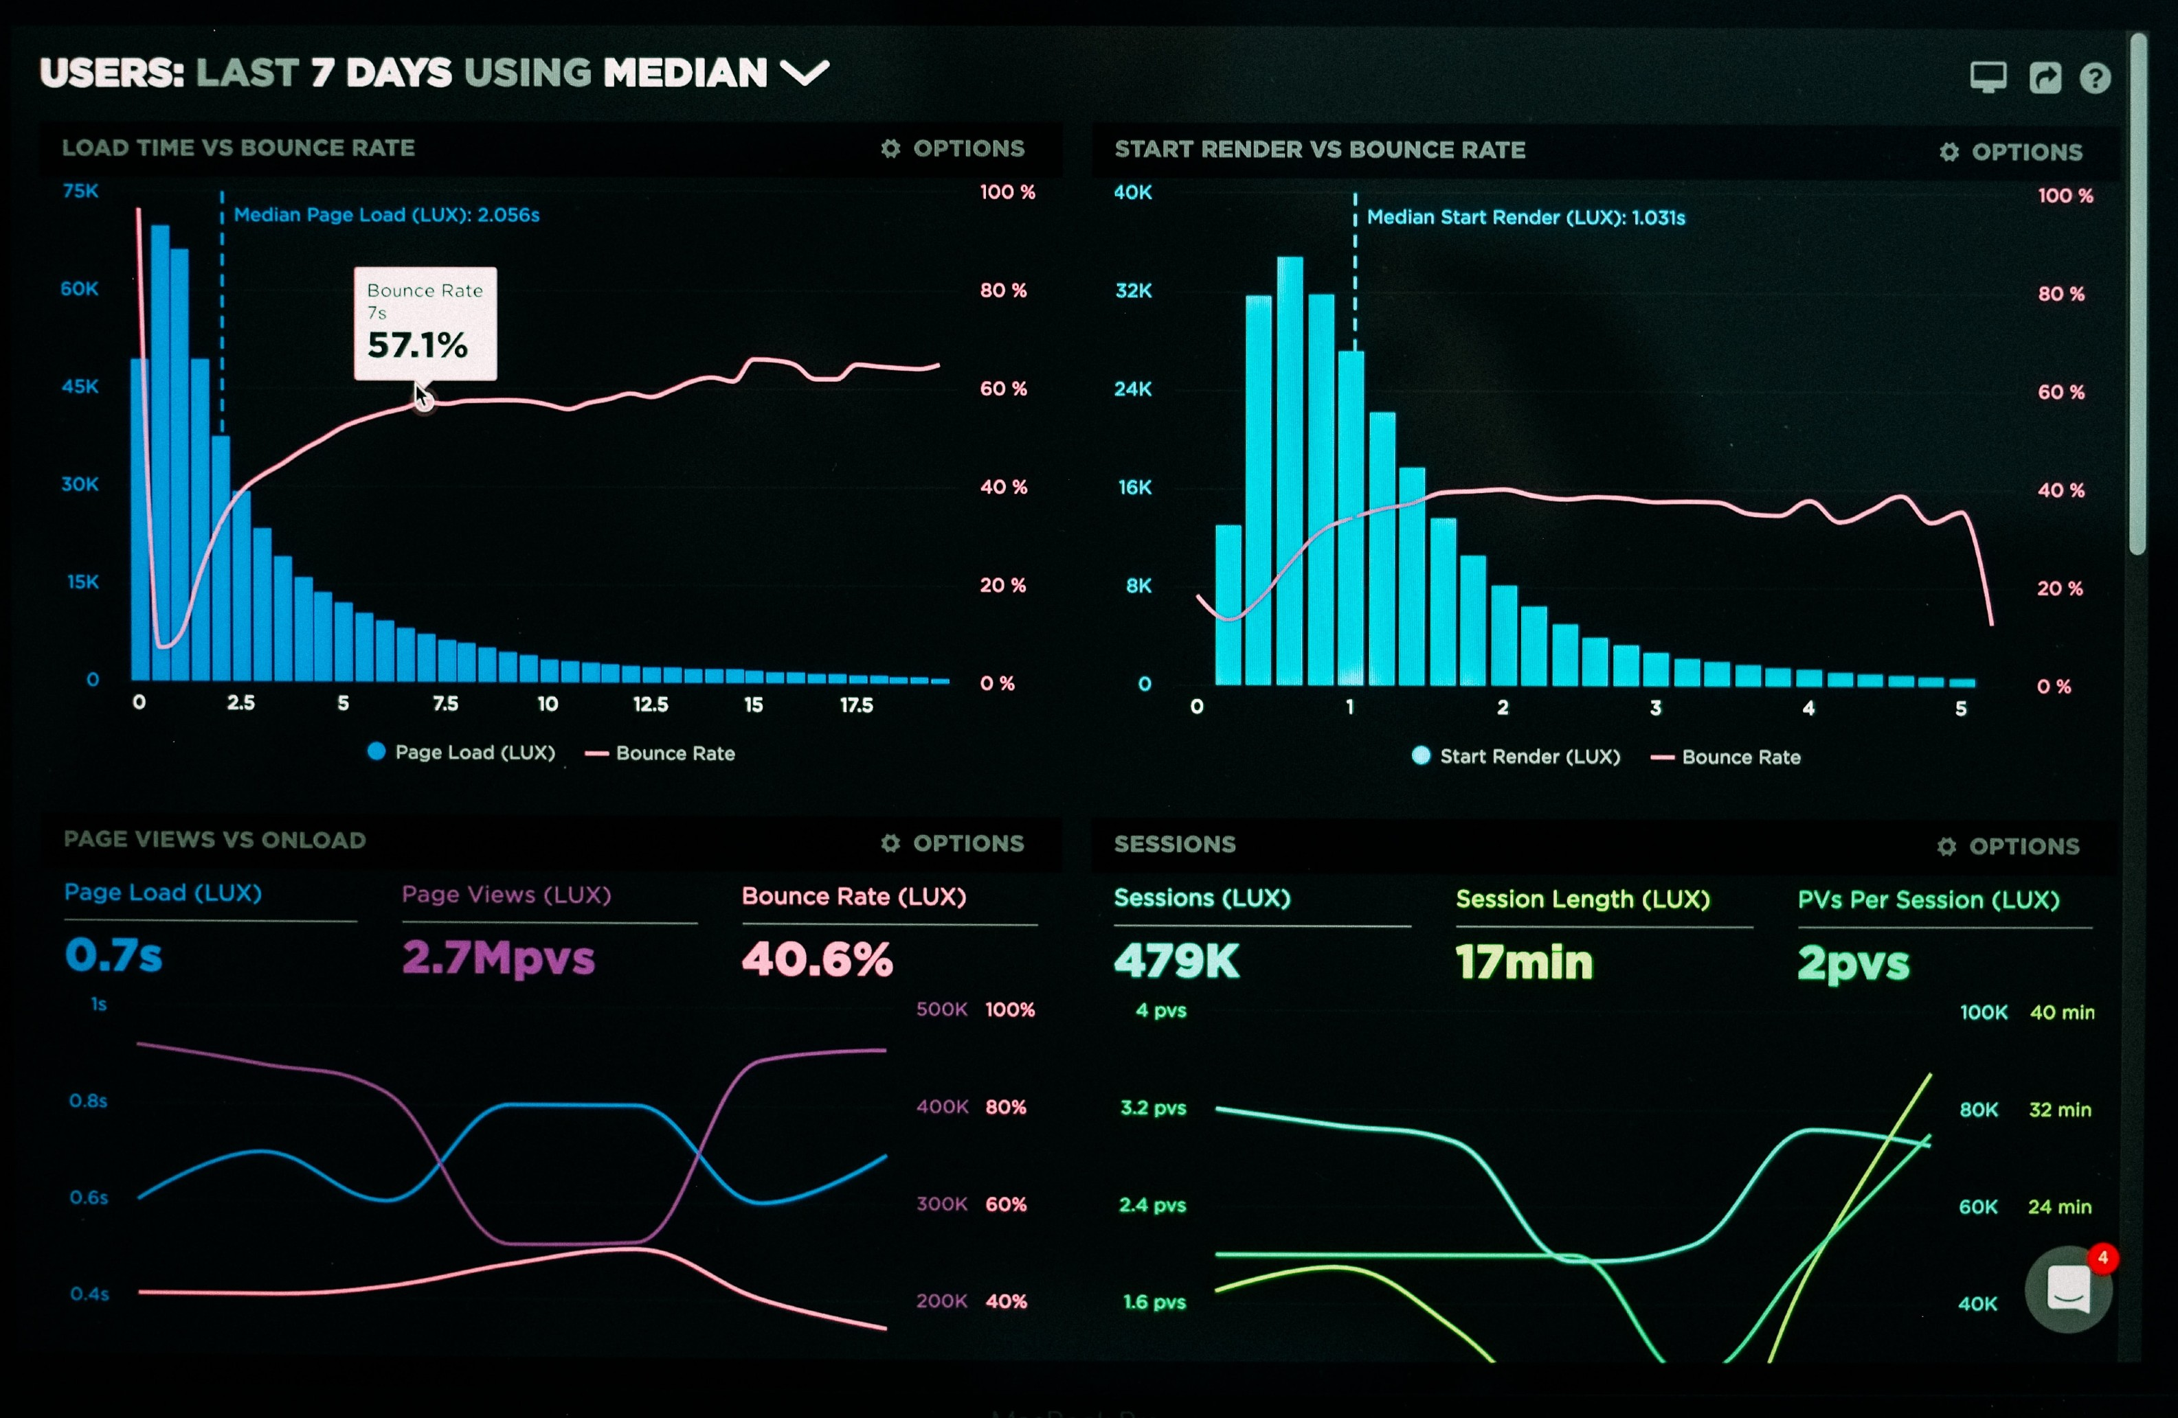
Notes:
What are THEIR motivators? Speed up processes, reduce calls to helpline? Highlight the risks of proceeding against your advice.

Slide 49
“Just change it to what I want”
4. Be strategic about what to concede

Slide 50

Notes:
Don’t be too dogmatic. Compromise. Win the war, not the battle. Be pragmatic. It’s a tricky line to draw, but you have to draw it.
Don’t get into “us and them”.

Slide 51

HI
THERE!
I HAVE OPINIONS TOO!
Notes:
Everyone can have an opinion, doesn’t mean you need to change anything. RACI is your friend.
You are the expert.
Feature creep? “talk to X who can write a ticket for the backlog” Documentation is your friend

Slide 52
Final recap

Slide 53
Final recap
Preparing: 80%

Slide 54
Final recap
Preparing: 80%
Peers: you’re in control

Slide 55
Final recap
Preparing: 80%
Peers: you’re in control
Experts: talk to them early

Slide 56
Final recap
Preparing: 80%
Peers: you’re in control
Experts: talk to them early
Stakeholders: what motivates them?

Slide 57
Final recap
Preparing: 80%
Peers: you’re in control
Experts: talk to them early
Stakeholders: what motivates them?

Slide 58
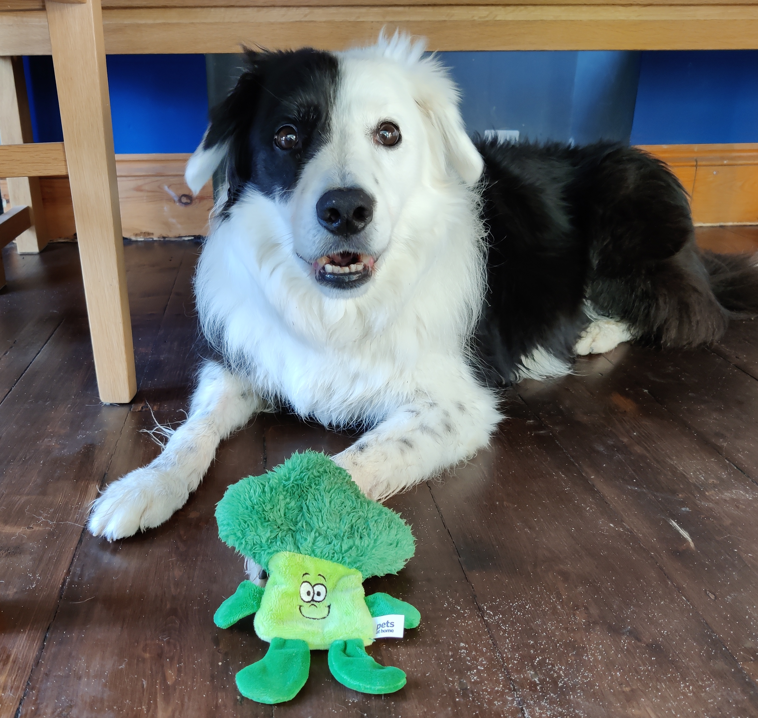
Thank you!
Milly Shaw
twitter.com/millyshaw

